Slide 1
CODE X
SHAAKIER RAILOUN
AQEEL HANSLO
SAKHUMZI KWAZA
AYAVUYA KOBE

Slide 2
Node js
What is Node JS? - Node.js is an open-source, server-side runtime environment that allows developers to run JavaScript code on the server. Node.js is well-suited for building scalable and high-performance network applications.
Why use Node JS? - Node.js is a versatile and powerful runtime environment that is used for building a wide range of applications. Its efficiency, scalability, and extensive ecosystem make it a popular choice among developers for various development projects.

Slide 3
React native
React Native is an open-source framework for building mobile applications using JavaScript and React, a popular JavaScript library for building user interfaces. React Native allows developers to create native mobile apps for multiple platforms, such as iOS, Android, etc., all while using a single codebase.
React Native components map to native UI elements, providing a native look and feel to the user interface, which results in a more responsive and performant app.

Slide 4

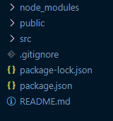
React native packages
Packages:
Extended capabilities of React Native
Diverse functionalities for mobile app development
2. Examples:
"react-navigation": Enables smooth screen navigation
"redux': Efficient state management tool

Slide 5
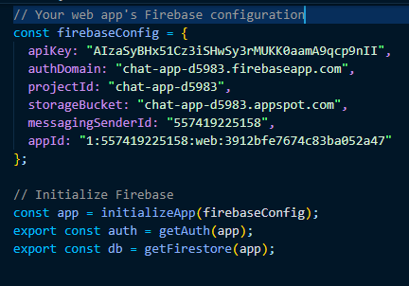
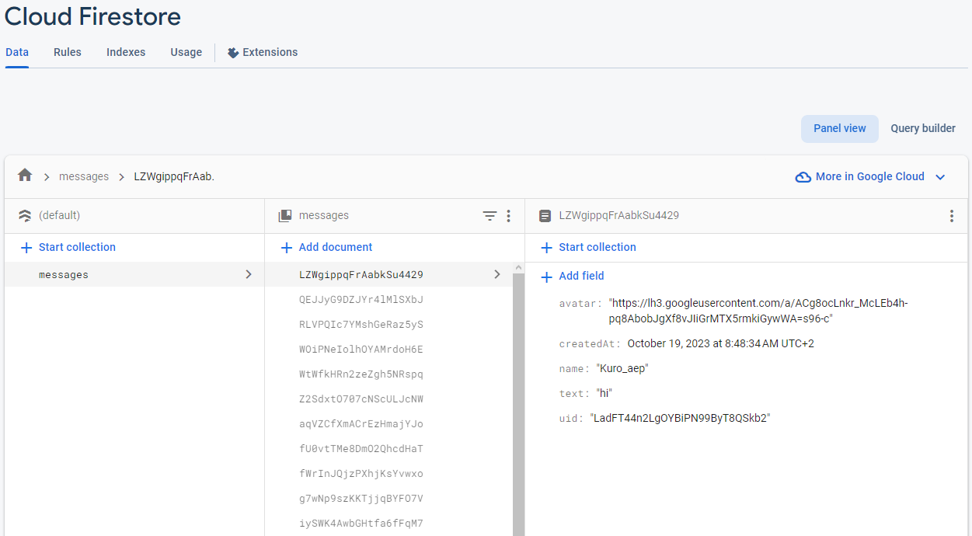
CHAT WEB APPLICATION
firebase

Slide 6
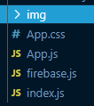
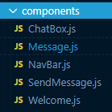
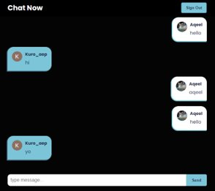
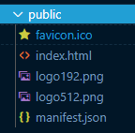
CHAT APPLICATION
components

Slide 7
ROCK PAPER SCISSOR GAME
About Rock Paper Scissor Game
How does the game work?
Challenges We faced
Why we recommend this game?

